Slide 1
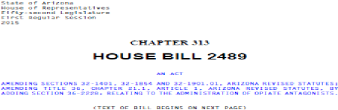

Naloxone
for Peace Officers and EMTs

Slide 2


Objectives
Background & statutes
Define naloxone
Routes of administration
Training requirements
Immunity

Slide 3
The Opioid Problem:
Lethal Drug overdose is the leading cause of
accidental death in America
41,502 drug overdose deaths in 2012
– 39% caused by opioids (approximately 16,186)
Opioids include legal prescriptions and illegal
drugs

Slide 4
Why Law Enforcement & EMTs?
Safe
Effective
Well-established practice
Few side effects
First step in combating deaths from overdose
– This is a time sensitive emergency
– Any delay in administration can result in death

Slide 5
ARS 36-2228
Requires a standing order issued by a licensed
physician or nurse practitioner
A trained EMT or Peace Officer may
administer Naloxone (or other FDA approved
opioid antagonists)
This may be administered if the EMT or Peace
Officer believes that the person is suffering
from an Opioid-related overdose

Slide 6
ARS 36-2228: Training
Requires uniform training module for both
EMTs and Peace Officers
Help providers identify persons suffering from
an opioid-related overdose
Training on use of Naloxone and other opioid
reversal drugs

Slide 7
ARS 36-2228: Immunity
Physicians or Nurse practitioners who issue a
standing order and EMTs and Peace Officers who
administer Naloxone pursuant to this training
ARE IMMUNE FROM CIVIL, PROFESSIONAL AND
CRIMINAL LIABILITY
This includes any decision made, action taken,
and injury that may result from the
administration
As long as those persons acted with reasonable
care and in good faith
Exceptions are wanton or willful neglect

Slide 8
Key Points
Licensed physician or Nurse practitioner
approval is MANDATORY
ADHS Approved Training is MANDATORY
Administration of Naloxone should follow an
ADHS approved protocol

Slide 9
What are Opioids
Opioids = synthetic drugs
Opiates = naturally derived from the poppy plant
Classified as depressants
– Central Nervous System (CNS) or brain function
– Respiratory
– Cardiovascular
Why are they abused?
– Euphoria (to “get high”) and pain control

Slide 10
How do they Kill?
Respiratory and CNS Depression
“Slows” everything down
Decreases level of consciousness
Decreases respiratory drive
Decreases heart rate and lowers blood
pressure

Slide 11
Decreased Respiratory Drive
How opioids kill
Body naturally wants to breath
This takes it away
Lose Consciousness -) lose drive to breath -)
lack of oxygen -) further loss of consciousness
-) DEATH
All can be reversed in a timely manner

Slide 12
Effect of Opioid Overdose
Hypoxia (Lack of oxygen)
Aspiration (inhaling vomit)
Cardiopulmonary arrest (“code”)
Increased incidence when combined with
alcohol, benzodiazepines (sedative,) or other
medications

Slide 13
Opioid Medications
Buprenorphine (Subutex)
Codeine
Fentanyl
Hydrocodone (Vicodin/Norco/Lortab)
Hydromorphone (Dilaudid)
Methadone
Morphine
Oxycodone (Percocet, Oxycontin)
Illegal Opioids = heroin and opium

Slide 14
Routes of Opioid Administration
Oral (pills)
Intravenous (IV)
Snorting
Smoking
Subcutaneous e.g. under the skin (“skin popping” during
the abuse of opioids)

Slide 15
Naloxone (Narcan)
Developed in the 1960s
Opioid antagonist (reversal drug)
Used as an emergent overdose treatment in
the hospital and prehospital settings
Increased need for Narcan due to:
- Greater variety of available opioids
- Increased opioid use and abuse

Slide 16
Mechanism of Action
Naloxone displaces the opioid from the opioid
receptor in the nervous system
Temporarily reverses respiratory and CNS
depression
May result in the sudden onset of opioid
withdrawal symptoms

Slide 17
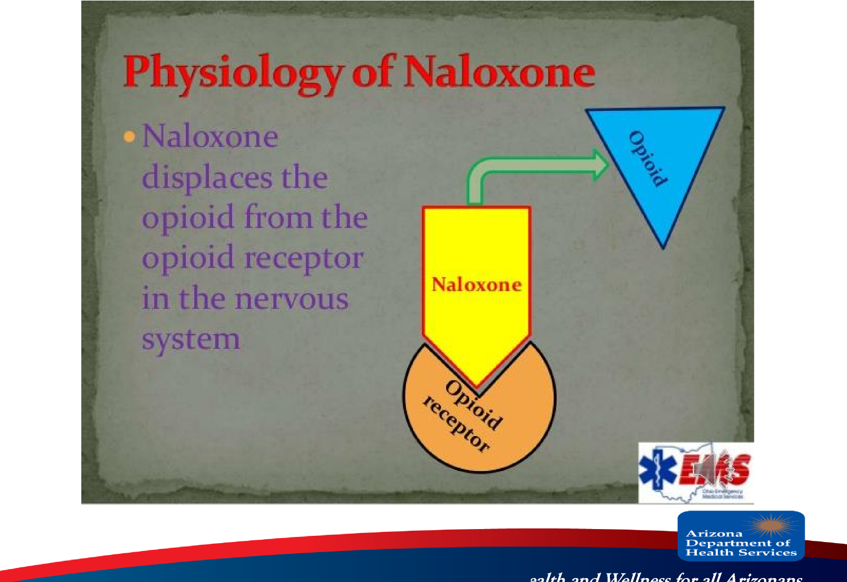
H

Slide 18
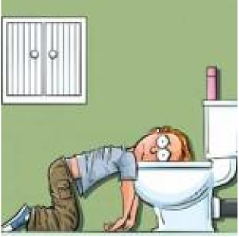
Signs & Symptoms of Opioid
withdrawal
– Agitation
– Tachycardia (rapid heart rate)
– Pulmonary edema (fluid in lungs)
– Nausea
– Vomiting
– Seizures

Slide 19
Naloxone Does Not Work for
Overdoses of
– Non-opioid Sedatives
Valium
Ativan
Xanax
Alcohol
– Stimulants
Cocaine
Amphetamines

Slide 20
Routes of Administration of Naloxone
EMTs & Peace Officers:
– Intramuscular (IM)
– Intranasal (IN)
Paramedics, AEMTs, I-99s :
– Intramuscular (IM)
– Intranasal (IN)
– Intravenous (IV)
– Intraosseous (IO)
– Endotracheal (ET)

Slide 21
Benefits of Naloxone Administration
by Intranasal Route or Auto-Injector
IV access may be difficult to establish in
chronic IV drug abusers
Decreased risk of needle stick injury
Decreased risk of potential infectious disease
exposure
Simple, rapid, convenient

Slide 22
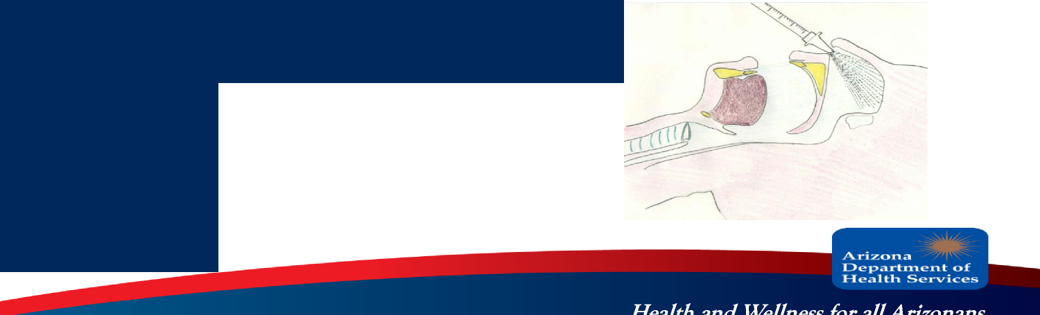
Why Intranasal (IN)
Works quickly since the nose has a large area for
absorbing drugs directly into the blood stream
Nose is an easy access point
Intranasal narcan starts working as fast as IV
Intranasal atomizers facilitate immediate
administration of Naloxone
Painless

Slide 23
Benefits of Naloxone Administration
by
Auto-Injector
Contains a pre-measured dose of medication
which reduces the risk of dosing errors
Designed for self-administration of medication
by patients and laypersons

Slide 24

Indications for Naloxone Use
Altered Level of Consciousness (LOC)
Respiratory depression or apnea (not breathing)
– Shallow, slow (<8-10 breathes per minute), or
inadequate
Unable to wake up with painful stimuli
Constricted pupils (miosis)
Needle track marks
Profuse sweating (diaphoresis)
Cardiac Arrest

Slide 25

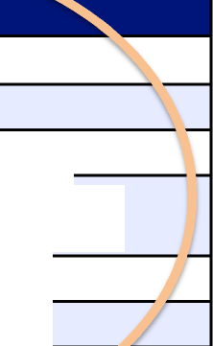

High vs. Overdose
REALLY HIGH
OVERDOSE
Muscles become relaxed
Pale, clammy skin
Speech is slowed/slurred
Very infrequent or no breathing
Sleepy looking
e)
Deep snoring or gurgling (death rattl
Responsive to stimuli (such as shaking, yellin r sternal rub, etc.)
Not responsive to stimuli (such as shaking, yelling, sternal rub, etc.)
Normal heart beat/pulse
Slow heart beat/pulse
Normal skin tone
Blue lips and/or fingertips
Arizona
Department of Health ServicIeS.

Slide 26
Simple Naloxone Algorithm
When to Use Naloxone
Chrerdose suspected
Not responsiive to parrilul
^{s}iti^{r}
Breathing status
Normal or Fast
Slow
iOx minute)
No or of Gasping
AP.
Turn en on side
Naloxone
Naloxone and
CPR
Arizona
Department of Health ServicIeS.

Slide 27
Safety Considerations
Post-administration considerations
* Use CAUTION when administering naloxone to
narcotic dependent patients!
* Rapid opiate withdrawal may cause nausea and
vomiting and may cause combativeness
* Roll patient to their side after administration to keep
airway clear
' If patient does not respond %thin 3-5 minutes,
administer second dose
ri ziarta
"'Department of Health Services

Slide 28
Safety Considerations
Other disease processes may mimic opioid
overdose (low blood sugar, head injury,
stroke, shock, hypoxia)
Naloxone has a short duration of action (half
life)
Patients may develop recurrent respiratory
and/ or CNS depression

Slide 29
Naloxone vs Drug Durations
Duration of Action of Opioids and Opioid Antagonists
naloxone methadone hydrocodone codeine oxycodone morphine/heroin meperidine fentanyl
J
1=1-
0 1 2 3 4 5 6 7 8
Duration of Action (hours)
Arizona
Eloepartirrierit of Health_ ServicIeS.

Slide 30
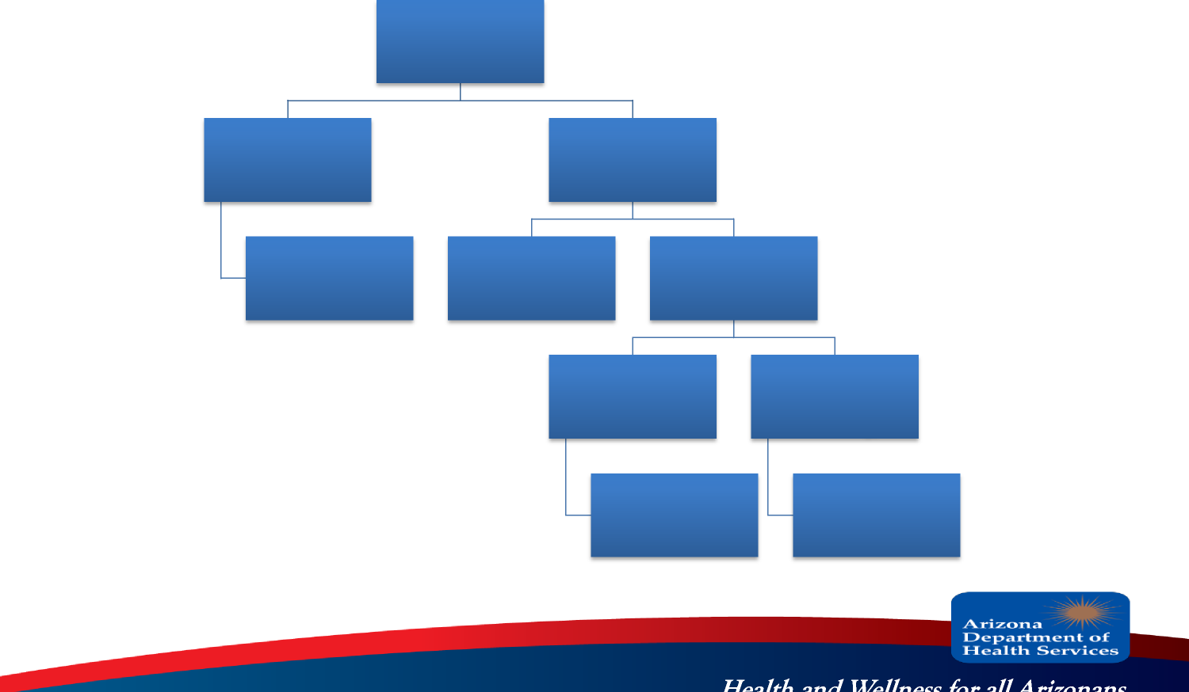
Procedure
Responsive and
adequate
breathing
Yes
NO
Monitor
Sternal
Rub/Stimulate
Breathing
Yes
(adequate)
No
(decreased or no
breathing)
Observe
Administer Narcan

Slide 31
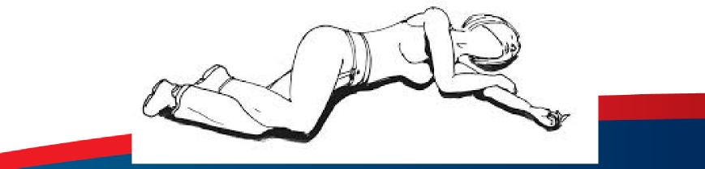
A Different Way
Recognize opiate overdose
– Decreased level of consciousness (LOC)
– Decreased or no breathing
– In setting of likely opiate ingestion
Give sternal rub/stimulate
– If no response →Administer Narcan
Place in recovery position

Slide 32
Naloxone Dosage (Adult & Pediatric)
Auto Injector IM:
– 0.4 mg IM dose.
– May repeat every 2-5 minutes as necessary.
– Max dose 4 mg.
Intra-nasal:
– 1.0 mg each nostril using a Mucosal Atomizer
Device for a total of 2 mg.
– May repeat every 3-5 minutes as necessary.
– Max dose 4 mg.

Slide 33
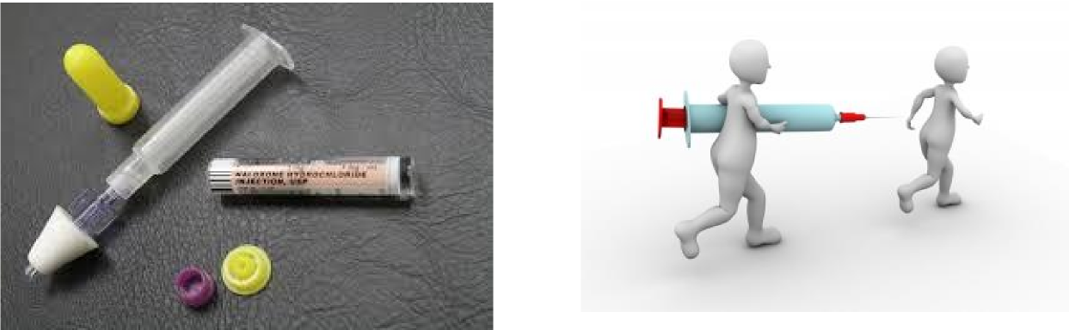
Naloxone Administration
Naloxone comes in liquid form
Pre-filled syringe

Slide 34
Administration
1st Identify overdose
– Does history and appearance seem consistent
with opioid overdose
Ensure EMS is en route
Gloves recommended
Assess for responsiveness and breathing
Attempt to stimulate the patient with a sternal
rub

Slide 35
Patients at risk for Opioid Overdose
Chronic users
– Especially high risk if recent release from
jail/detox facility or with relapse
Young adults and teens experimenting with
drugs
People with chronic illnesses and chronic pain
– ALL ages and demographics

Slide 36
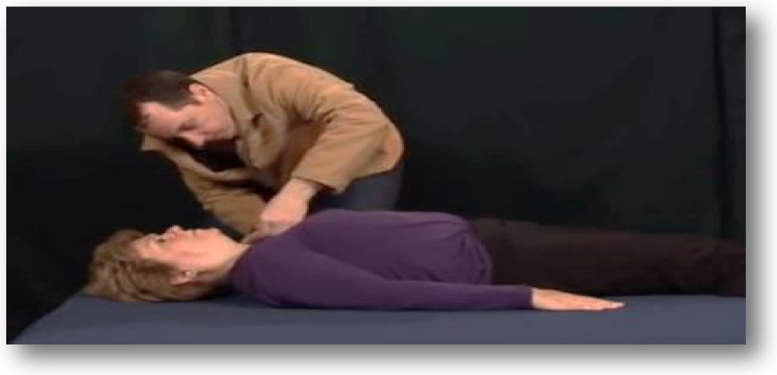
Sternal Rub

Slide 37
IN NALOXONE ADMINISTRATION
Take the cap off the medication.
Remove the two caps from each end of the applicator.
If not previously done, apply the atomizer onto the end of the applicator.
Tightly screw the medication into the applicator.
Insert the atomizer into the nostril and push the syringe.
Apply one milliliter (ml) into each nostril. The amount is measured on the
side of the syringe.

Slide 38
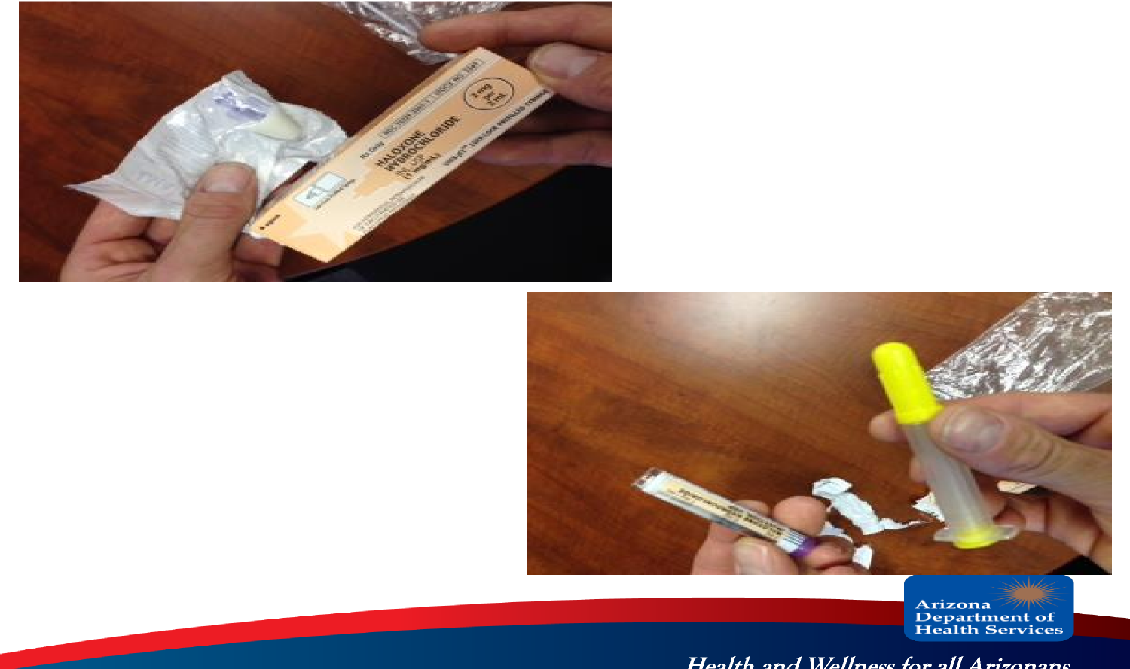
IN Naloxone Administration

Slide 39
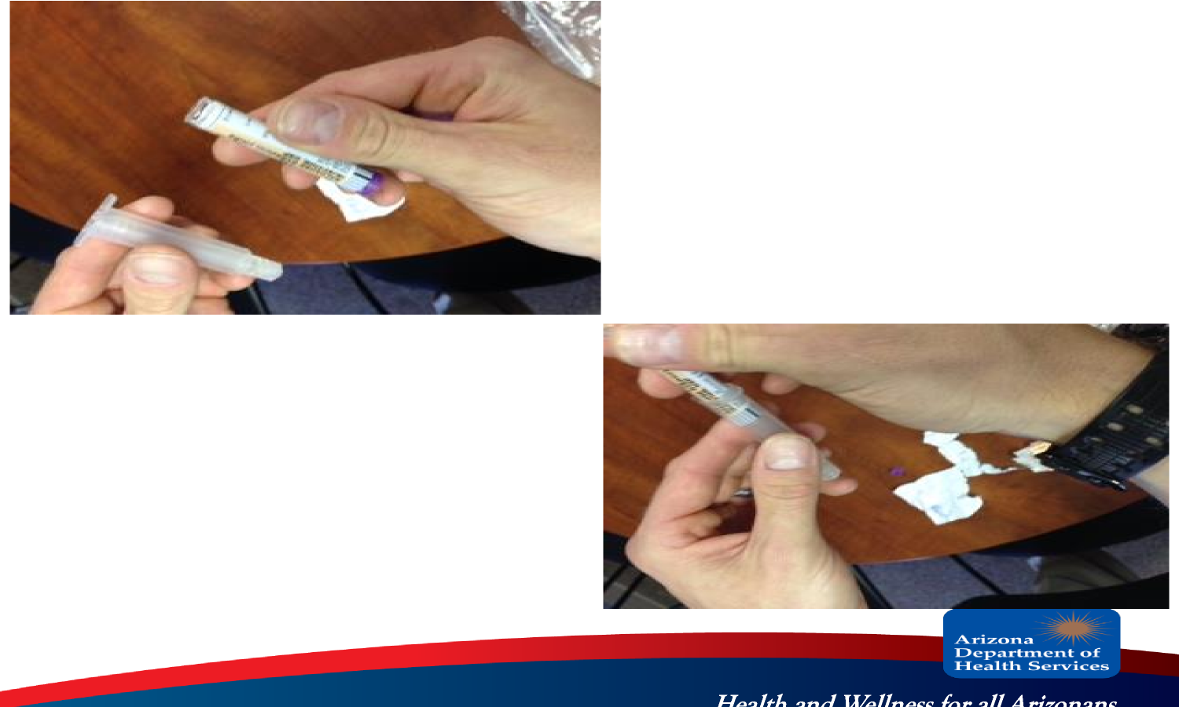
IN Naloxone Administration

Slide 40
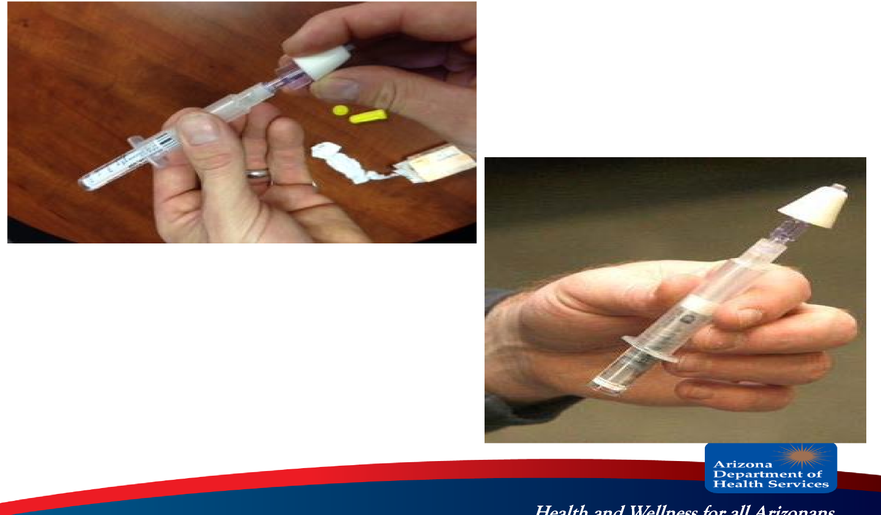
IN Narcan Administration

Slide 41
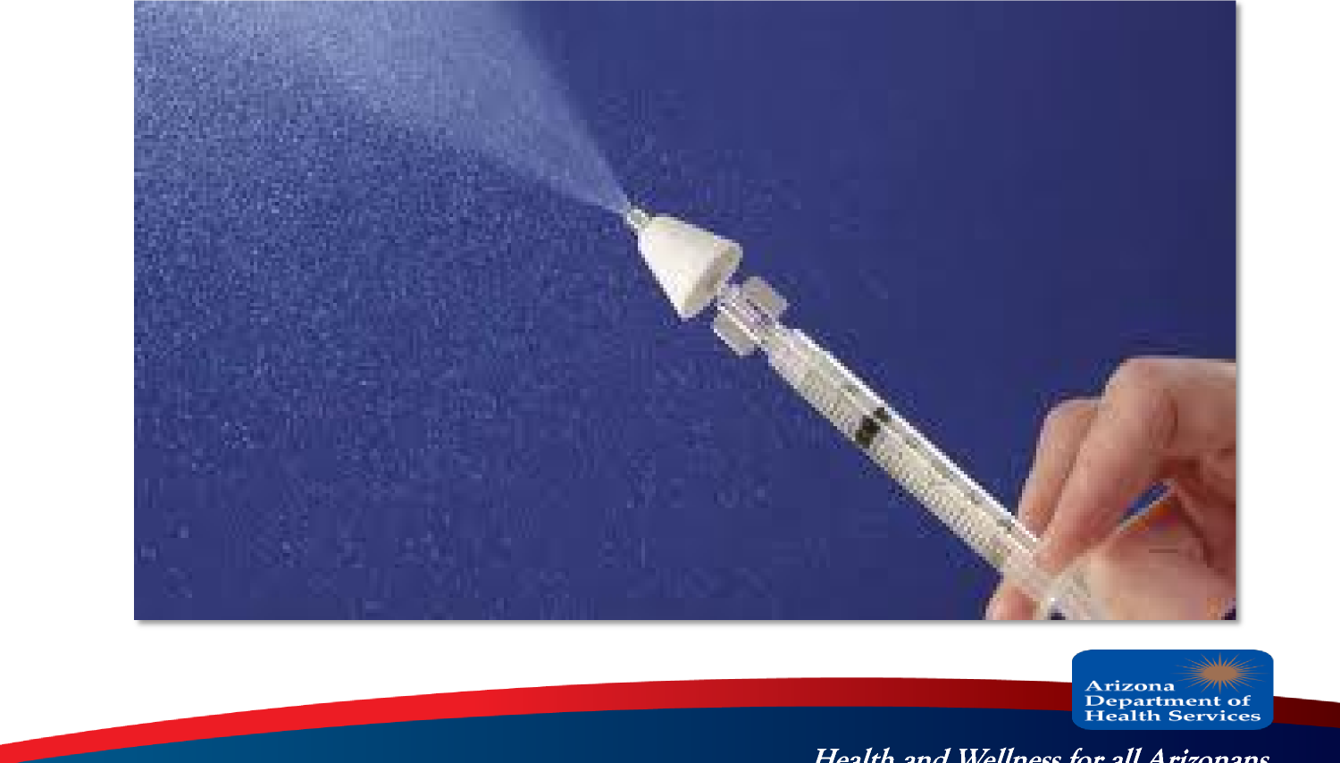
IN Naloxone Administration

Slide 42
IN Naloxone Administration Technique
The tip of the syringe should be placed near or
just inside the nostril
Placement of the syringe too far inside the
nasal cavity may traumatize the nasal
passages or cause bleeding (epistaxis)
The use of a mucosal atomization device
(MAD) on the tip of the syringe prevents nasal
trauma and maximizes the delivery of the
medication to the patient

Slide 43
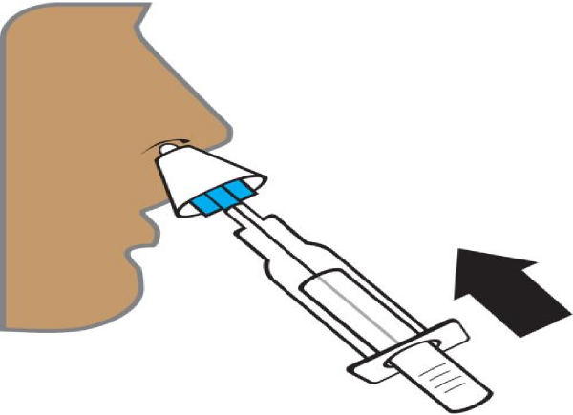
Administration
 | Spray half (1 ml) up one nostril and half up the other nostril

Slide 44
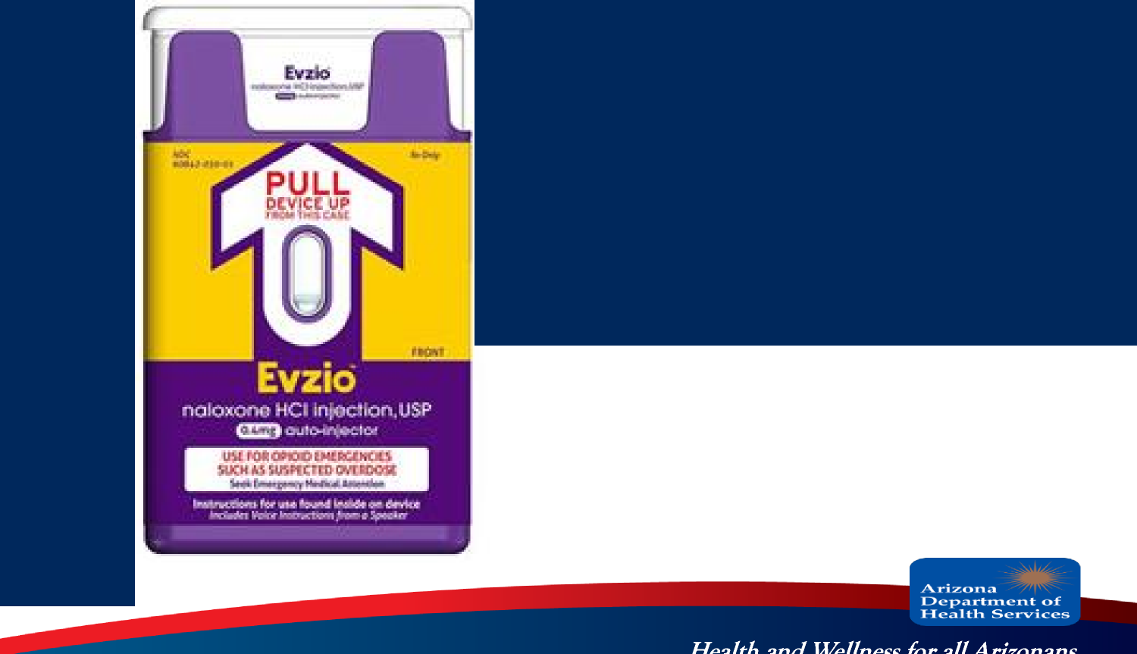
Naloxone Auto-Injector (IM)
Currently 1 FDA
approved manufacturer
Dose = 0.4 mg/auto-
injector
1 dose per package
Not reusable

Slide 45
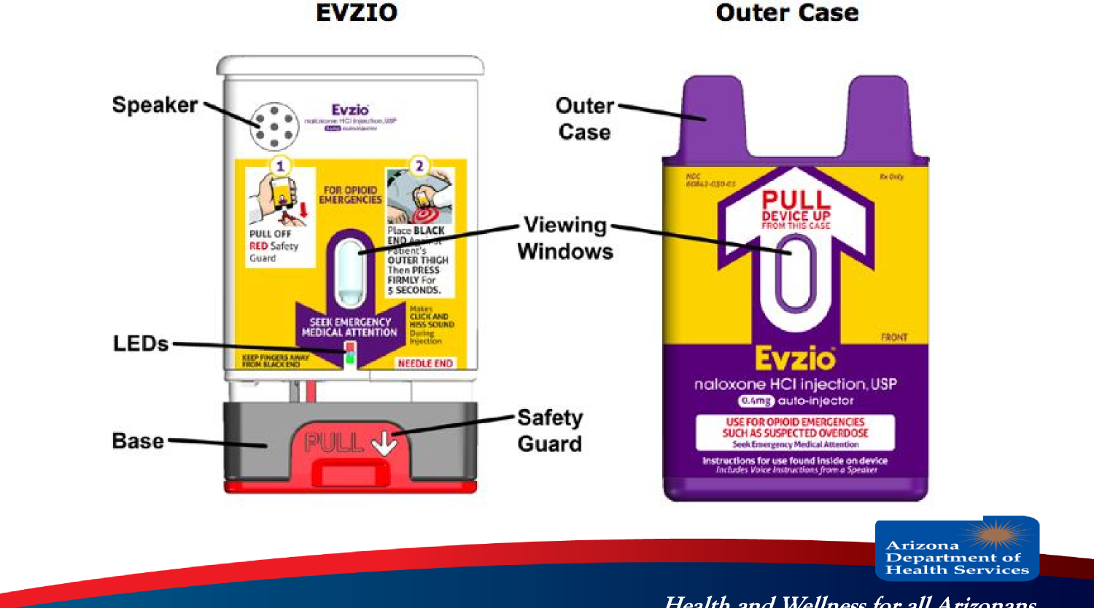
Evzio Naloxone Auto-Injector

Slide 46
Naloxone Auto-Injector (IM)
Pull EVZIO from the outer case
Pull off the red safety guard.
Do not touch the black base of the auto-injector,
which is where the needle comes out.
Note: The red safety guard is made to fit tightly. Pull
firmly to remove.
Do not replace the red safety guard after it is
removed.

Slide 47
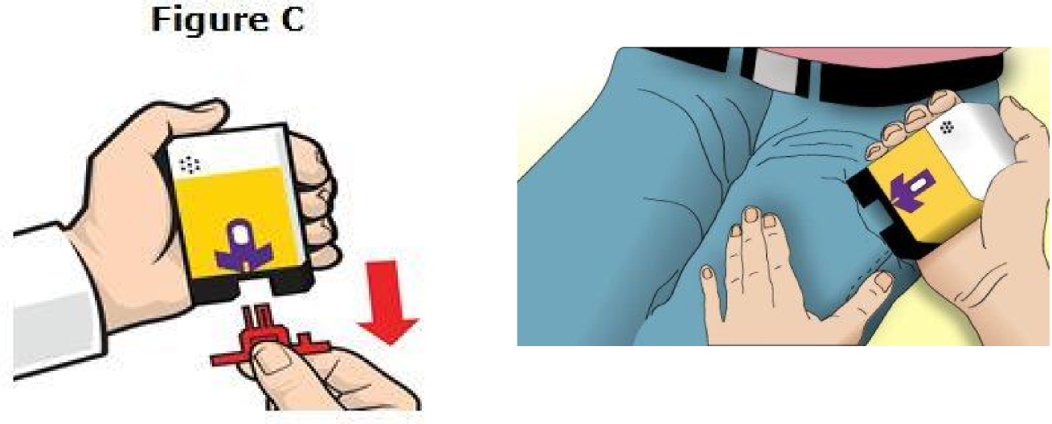
Evzio Naloxone Auto-Injector

Slide 48
Naloxone Auto-Injector (IM)
Place the black end against the middle of the
patient's outer thigh, through clothing (pants, jeans,
etc) if necessary.
Then press firmly and hold in place for 5 seconds.
EVZIO to an infant less than 1 year old, pinch the
middle of the outer thigh before you give EVZIO and
continue to pinch while you give EVZIO.

Slide 49
Naloxone Auto-Injector (IM)
EVZIO makes a distinct sound (click and hiss) when it
is pressed against the thigh.
This is normal and means that EVZIO is working
correctly.
Keep EVZIO firmly pressed on the thigh for 5 seconds
after you hear the click and hiss sound.
The needle will inject and then retract back up into
the EVZIO auto-injector and is not visible after use.

Slide 50
Handling of Auto-Injector Post Use
EVZIO cannot be reused.
After use, place the auto-injector back into its outer
case
Do not replace the red safety guard.

Slide 51
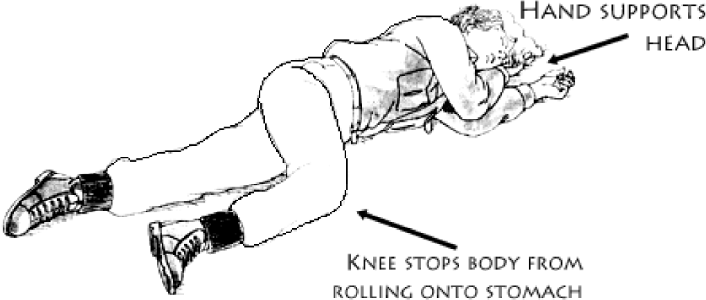
Recovery Position

Slide 52
Response Review
Stimulate (sternal rub)
Alert EMS
Administer naloxone (Intranasal or intramuscular)
CPR – Rescue breathing/ventilations
Repeat 3 & 4, if necessary
Recovery position, if breathing

Slide 53
Side Effects of Naloxone
If the person is not overdosing on an opioid it
will have no effect
Precipitation of withdrawal symptoms
– Vomiting/diarrhea
– Agitation
It can not be used to get high

Slide 54
Follow Up
Even if the person wakes up and starts
breathing, the OVERDOSE could come back
The effects of heroin last much longer that
NALOXONE
The patient should be transported to the
hospital with EMS

Slide 55
Documentation for Peace Officers
Recommended state tracking form should be
completed after each use of Naloxone
Data to collect:
– Patient name & DOB
– Location of incident/administration
– Indication – to include check box of options
– Dose & route naloxone administered
– Response to administration
– Patient disposition (EMS, DOA, Elope, etc)

Slide 56
QUESTIONS?

