Slide 1
CRITICAL CARE TRANSPORT MEDICATIONS

Slide 2
Why These and Why Now?
Arizona Department of Health Services has determined that paramedics trained properly can transport patients with these three medications
Three critical care medications have been approved for use in transport
Levophed/Norepinephrine
Diprivan/Propofol
Insulin

Slide 3
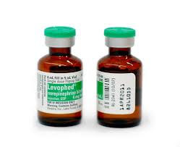
Levophed/Norepinephrine

Slide 4
Levophed/Norepinephrine
Uses
Severe Hypotension after IVF’s and possibly Dopamine
Septic Shock
Hypotension associated with AMI

Slide 5
Levophed/Norepinephrine
Mechanism of Action
Identical to norepinephrine produced in the adrenal glands
Primarily a αreceptor agonist causing vasoconstriction
β1 agonist, so has inotropic and chronotropic effects
Little effect on β2 receptors like epinephrine

Slide 6
Levophed/Norepinephrine
Dosing and Administration
Only delivered as an IV infusion
Initial dose is 0.5 to 1 μg/min, titrated at a rate of 1 to 2 μg/min every 3-5 minutes
Maintain systolic blood pressure to 80-100 mmHg

Slide 7
Levophed/Norepinephrine
Adverse Effects
Ventricular irritibility
Reflex Tachycardia/Parasymphathetic stimulation
Decreased renal blood flow
Necrosis with extravasation

Slide 8
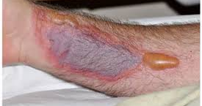
Levophed/Norepinephrine

Slide 9
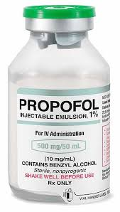
Diprivan/Propofol

Slide 10
Diprivan/Propofol
Uses
Sedation for ventilated patients
Induction agent
Procedural Sedation

Slide 11
Diprivan/Propofol
Mechanism of Action
Sedative-hypnotic agent
Rapid onset and reversal when discontinued
Thought to act on the GABA receptors in the central nervous system

Slide 12
Diprivan/Propofol
Dosing and Administration
IV infusion only
5-50 μg/kg/min
Start at 5 μg/kg/min and titrate 5-10 μg/kg/min every 5-10 minutes to desired sedation
Generally not used in pediatrics maintenance sedation

Slide 13
Diprivan/Propofol
Adverse Effects
Hypotension
Respiratory depression
Involuntary muscle movements
Bradycardia
Pulmonary edema
Propofol Infusion Syndrome

Slide 14
Diprivan/Propofol
Propofol Infusion Syndrome
Severe metabolic acidosis
Hyperkalemia
Lipemia
Rhabdomyolysis
Renal Failure
EKG changes

Slide 15
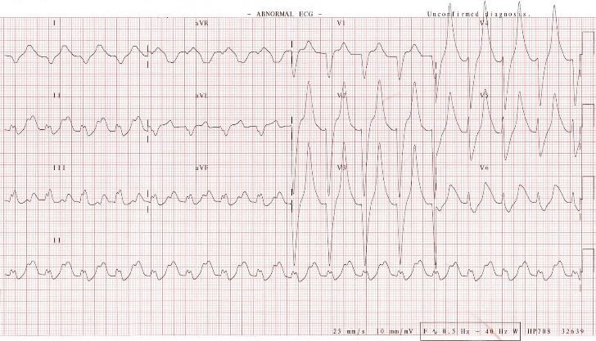
Diprivan/Propofol

Slide 16
Diprivan/Propofol

Slide 17
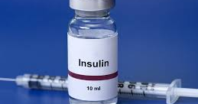
Insulin

Slide 18
Insulin
Uses
Hyperglycemia
DKA
Hyperosmolar Hyperglycemic State
Drug Overdoses(beta blockers, calcium channel blockers)

Slide 19
Insulin
Mechanism of Action
Regulatory hormone, normally produced by the pancreas
Allows glucose uptake by cells by combining with cellular wall receptors
Diabetics either no longer produce insulin or the cellular receptors become resistant
Inhibits gluconeogenesis, lipolysis, catabolic hormone secretion and production of ketoacids
Promotes K+, glucose and phosphate uptake at the cellular level

Slide 20
Insulin
DKA/HHS
Need continuous infusion of insulin to reverse the metabolic acidosis or hyperosmolar state by decreasing the hyperglycemia
Must monitor potassium levels carefully/EKG changes related to hypokalemia ie. T wave flattening, prominent U waves and ST segment depression

Slide 21
Insulin
Dosing and Administration
Continuous IV infusion
Initial dose is 0.1 U/kg/hr
Dose may be adjusted upwards or downwards depending on the clinical scenario

Slide 22
Insulin
Adverse Effects
Hypoglycemia
Hypokalemia
Hypophosphatemia
Cerebral edema
ARDS

Slide 23
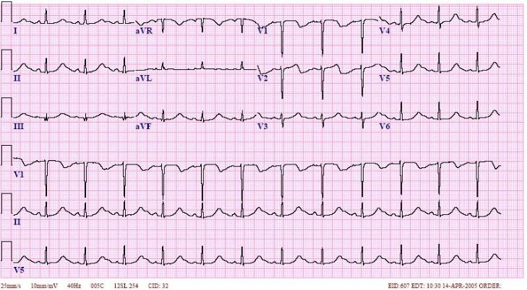
Insulin

Slide 24
Take Home Points
Know what each drugs does
Know the proper dosing of each drug
Know what adverse side effects to watch for
Be Safe, Be Smart and Be Beside the Patient

Slide 25
QUESTIONS

