Slide 1
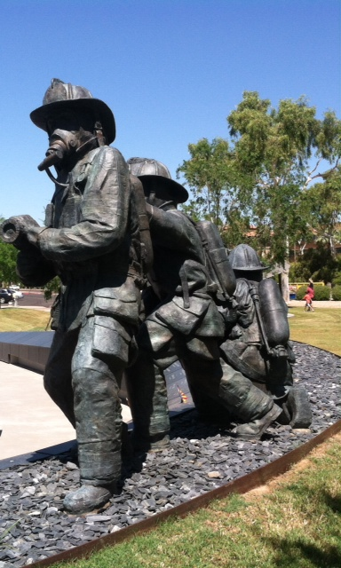
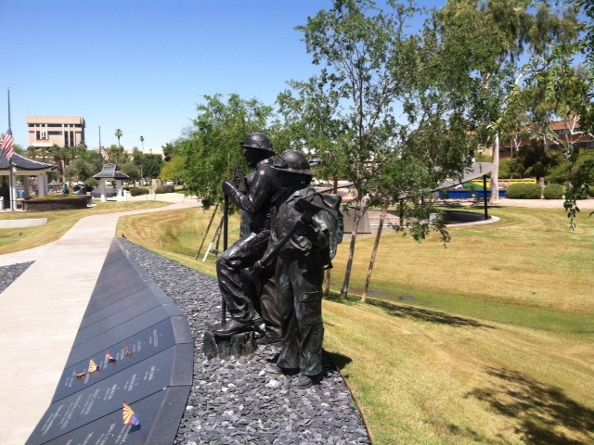
Recertification
Required Content
or
What do I Need to Recertify?

Slide 2

Remember that YOU are responsible for recertifying every two years. The certification belongs to you and NOT the agency you work for!

Slide 3
R9-25-305. Supplemental Requirements for Specific Courses (Authorized by A.R.S. §§ 36-
2202(A)(3) and (4) and 36-2204(1) and (3))
3. The EMT refresher course covers:
a. The knowledge, skills, and competencies in the national education standards
established at the EMT classification level;

Slide 4
EMT’s can recertify in four ways:
Current CPR card mirroring AHA and accepted by their agency (Competency Based) and:
24 hour traditional refresher using the content from a National Certification organization (Includes 150 question written exam and
Practical skills tests
24 hours of CE’s mirroring the content of a traditional refresher course, or
Arizona Challenge Examination with questions
on the content from the above refresher and practical skills examination, or….
Current National Registry / Challenge National Registry EMT Psychomotor and CBT exams. Current National Registry can be submitted for new Arizona Certification

Slide 5
Mandatory Core Content
Preparatory 1 Hour Roles and Responsibilities, Well Being of the EMT, Medical Direction, Quality Improvement, Personal Protection, Scene Safety, Medical/Legal,
Human Anatomy, Lifting and Moving
Airway 2 Hours Basic Airway Management, Oxygen Delivery Systems and techniques, Oxygen Therapy, Adjuncts
OB, Infants and Children 2 Hours Obstetrical Emergencies, Childbirth and Complications, Care of the Newborn, Assessing the Pediatric Patient, Medical Emergencies in Pediatric Patients, Airway Management in Pediatric Patients, Trauma Emergencies and Care in Pediatric patients
Patient Assessment 3 Hours Scene Size-up, Primary Survey, Vital Signs and History Taking, Assessment of Trauma Patients, Assessment of Medical Patients, Secondary Assessment, Communications, Documentation
Medical / Behavioral 4 Hours General Pharmacology, Respiratory Emergencies, Environmental Emergencies, Acute Abdominal Emergencies, Diabetic Emergencies, Allergic Reactions, Poisoning and Overdose, Behavioral Emerge

Slide 6
Mandatory Core Content
Continued
Trauma 4 Hours Management of Shock, Bleeding/Wounds, Soft Tissue Injuries, Musculoskeletal Injuries, Chest Trauma, Injuries to Head and Spine, Burns
Elective 8 Hours Emergency Driving, HAZMAT, Ambulance Operations, Incident Command System
Total 24 Hours
The State of Arizona requires a mandatory 5 hours of Pediatric content to be included as part of the 24 hours. This required content could be included in the Elective section of your refresher or CE’s. Since 2 hours are listed in the core content, a minimum of 3 hours should be added in the Elective content.
Your documentation for recertification should include, a course completion certificate from a 24 hour refresher course, Individual CE’s reflecting the topic and hour content of a 24 hour refresher course , or a course completion certificate from an Arizona Challenge Examination from a state certified training center, and a valid CPR card mirroring AHA and accepted by their agency.

Slide 7
Paramedic’s can recertify in four ways:
Current CPR card and a current ACLS card mirroring AHA and accepted by their agency (CPR & ACLS competency based) and:
48 hour traditional refresher using the content from a National Certification organization to include 150 question written exam and practical skills test
48 hours of CE’s mirroring the content of a traditional refresher course, or
Arizona Challenge Examination with questions
on the content from the above refresher, or….
Challenge National Registry Paramedic Psychomotor and CBT exams. Current National Registry can be submitted for new Arizona Certification

Slide 8
Mandatory Core Content
Airway, Breathing, and Cardiology 8 Hours
• Provide ventilatory support for a patient
• Attempt to resuscitate a patient in cardiac arrest
• Provide care to a patient who is experiencing cardiovascular compromise
• Provide post-resuscitation care for a cardiac arrest patient
Medical Emergencies 3 Hours
• Assess and provide care to a patient who is experiencing an allergic reaction
• Assess and provide care to a patient who has a possible overdose
• Assess and provide care to a drowning patient

Slide 9
Trauma 5 Hours
• Perform a primary survey
• Assess a patient who has a head injury
• Assess and provide care to a patient who has a suspected spinal injury
• Provide care to a patient who has a chest injury
• Provide care to a patient who has an open abdominal injury
• Provide care to a patient who has shock/hypoperfusion
Obstetrics and Pediatrics 8 Hours
• Assess and provide care to an infant or child in cardiac arrest
• Assess and provide care to an infant or child who has respiratory distress
• Assess and provide care to an infant or child who has shock/hypoperfusion
• Assess and provide care to an infant or child who has trauma

Slide 10
Flexible Core Content
Airway, Breathing, and Cardiology 8 Hours
• Assess and provide care for an adult patient who has respiratory distress
• Use oxygen delivery system components
• Perform techniques to ensure a patent airway
• Assess and provide care to a patient who is experiencing non-traumatic chest pain/discomfort
Medical Emergencies 5 Hours
• Assess and provide care to a patient who has altered mental status
• Assess and provide care to a patient who has a history of diabetes
• Assess and provide care to a patient who is experiencing a seizure
• Assess and provide care to a patient who was exposed to heat or cold
• Assess and provide care to a patient who is experiencing a behavioral problem
• Assess and provide care to a patient who has a suspected communicable disease

Slide 11
Flexible Core Content
Trauma 1 Hour
• Provide care to a patient who has a painful, swollen, deformed extremity
• Assess and provide care to a patient who has a burn injury
Obstetrics and Pediatrics 8 Hours
• Assess and provide care to an infant or child who has suspected non-accidental trauma or neglect
• Assess and provide care to an infant or child who has a fever
• Assess and provide care to an obstetric patient
• Provide care to a newborn
• Provide care to a mother immediately following delivery of a newborn

Slide 12
Flexible Core Content
Operational Tasks 2 Hours
• Use body mechanics when lifting and moving a patient
• Communicate with a patient while providing care
The State of Arizona requires a mandatory 5 hours of Pediatric content to be included as part of the 48 hours.
Your documentation for recertification should include, a course completion certificate from a 48 hour refresher course, Individual CE’s reflecting the topic and hour content of a 48 hour refresher course , or a course completion certificate from an Arizona Challenge Examination from a state certified training center, and both a valid CPR card ACLS card mirroring AHA and accepted by their agency.

Slide 13
National Certification Organization
Brochures
https://content.nremt.org/static/documents/emt-recert-brochure.pdf
https://content.nremt.org/static/documents/paramedic-recert-brochure.pdf

Slide 14
What is NCCP and who does it pertain to?
NCCP (National Core Competency Program is the new National Registry recertification process.
Arizona is an NCCP state, meaning that all Arizona providers who recertify National Registry, may use this model to recertify their Arizona cert.

Slide 15
Associated Hours for NCCP
EMT 40 hours total
National Registry Evidence based content to be updated bi-annually – 20 hrs. (Modules)
State of Arizona / Agency – 10 hrs. (5 hrs. Peds) required by state.
Provider choice – 10 hours
No exams on the backend

Slide 16
Associated Hours for NCCP
Paramedic – 60 hours total
National Registry Evidence based content to be updated bi-annually 30 hrs. (Modules)
State of Arizona / Agency 15hrs. (5 hrs. Peds required by state)
Providers choice 15 hrs.
No exam on the backend

Slide 17
National Certification Organization
Brochures
https://content.nremt.org/static/documents/emt-nccp-brochure.pdf
https://content.nremt.org/static/documents/aemt-nccp-brochure.pdf
https://content.nremt.org/static/documents/paramedic-nccp-brochure.pdf

Slide 18
Questions???
Douglas Crunk
EMS Education and Training Manager
Bureau of EMS and Trauma System
douglas.crunk@azdhs.gov
602-364-3189

Slide 19
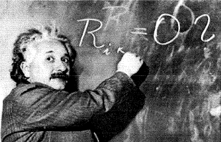
.
“ Education is what remains after one has forgotten what one has learned in school.”
Albert Einstein

